Slide 1
ZLAN Switch System
Connecting Your Power Grid to the Internet

Slide 2
Table of Contents
1. Introduction
2. System Architecture
3. Frontend
4. Backend
5. Service Layer
6. Challenges & Solutions
7. Future Enhancements
8. Demo
9. Q&A

Slide 3
Overview
Project Overview:
Development of a comprehensive Meter Monitoring System for real-time electrical energy data visualization and analysis
Objectives:
Collect accurate meter readings via Modbus TCP communication.
Store data efficiently using FastAPI backend with SQLite database.
Provide an interactive frontend dashboard with real-time updates and historical data filtering.
Enable easy deployment and scalability across different devices.
Key Benefits:
Improved energy monitoring and management.
User-friendly interface for data insight.
Reliable and extensible architecture.

Slide 4
System Architecture
Three Core Components:
Frontend: React-based dashboard for data visualization and user interaction.
Backend: FastAPI REST API with SQLite database for data storage and querying.
Service Layer: Python script communicating with energy meters via Modbus TCP, pushing data to backend.
Data Flow:
Service reads data from meters → sends readings to backend API → backend stores in database → frontend fetches and displays data in real-time.
Technologies Used:
React, shadcn/ui for frontend UI
FastAPI, SQLAlchemy, SQLite for backend
pymodbus for Modbus communication in service
Deployment:
Each component runs independently but communicates over HTTP (backend & frontend) and network (service & backend).

Slide 5
Frontend
Technology Stack:
React with Next.js app router
shadcn/ui components for polished UI
Recharts for interactive data visualization
Key Features:
Real-time meter readings with automatic refresh
Date selector to filter data by specific day
Connection status indicators and manual refresh button
User Experience:
Clean, intuitive dashboard layout
interactive line charts showing power, voltage, current trends
Smooth transitions and tooltips for detailed data inspection

Slide 6
Backend
Framework & Database:
FastAPI for high-performance REST API
SQLite database for lightweight, file-based storage
SQLAlchemy ORM for easy database interaction
Core Responsibilities:
Receive and store meter readings via POST endpoints
Serve filtered and paginated data via GET endpoints
Handle date-based queries to support frontend filtering
Additional Features:
CORS enabled for frontend-backend communication
Environment variable configuration for flexibility
Data persistence with efficient file/database management
Scalability:
Modular design to allow future upgrades to more powerful databases if needed

Slide 7
Service Layer
Purpose:
Continuously collect real-time data from electrical meters via Modbus TCP protocol.
Implementation:
Python script using pymodbus library to communicate with meters over the network.
Reads parameters like voltage, current, power, frequency, and energy at set intervals.
Data Handling:
Posts collected readings to the backend API for storage
Handles connection retries and error logging to ensure reliability.
Deployment:
Runs independently, can be hosted on the same network as meters or backend.
Easily configurable via environment variables (e.g., meter IP address).

Slide 8
Challenges
Handling Missing Data
Null or incomplete meter readings addressed by interpolation and last-known-value fill strategies in the backend.
Real-time Updates & Connectivity:
Ensured reliable data flow with periodic polling and connection status indicators on the frontend.
Date Filtering & User Interaction:
Implemented flexible date selectors with proper formatting and backend support for efficient querying.
Scalability & Extensibility:
Designed modular architecture allowing easy upgrade from SQLite to more robust databases as needed
Deployment Complexity:
Simplified setup with environment variables and clear separation of concerns across components.

Slide 9
Future Enhancements
Advanced Data Analytics: Implement predictive analytics and anomaly detection for proactive energy management.
Mobile Application: Develop a mobile app to provide on-the-go access and notifications.
Extended Device Support:Add compatibility with additional meter models and communication protocols.
User Management & Security:Integrate authentication, role-based access, and encrypted data transmission.
Cloud Deployment & Scaling: Migrate backend to cloud infrastructure for higher availability and scalability.
Improved Visualization:
Introduce customizable dashboards and multi-metric comparisons.

Slide 10
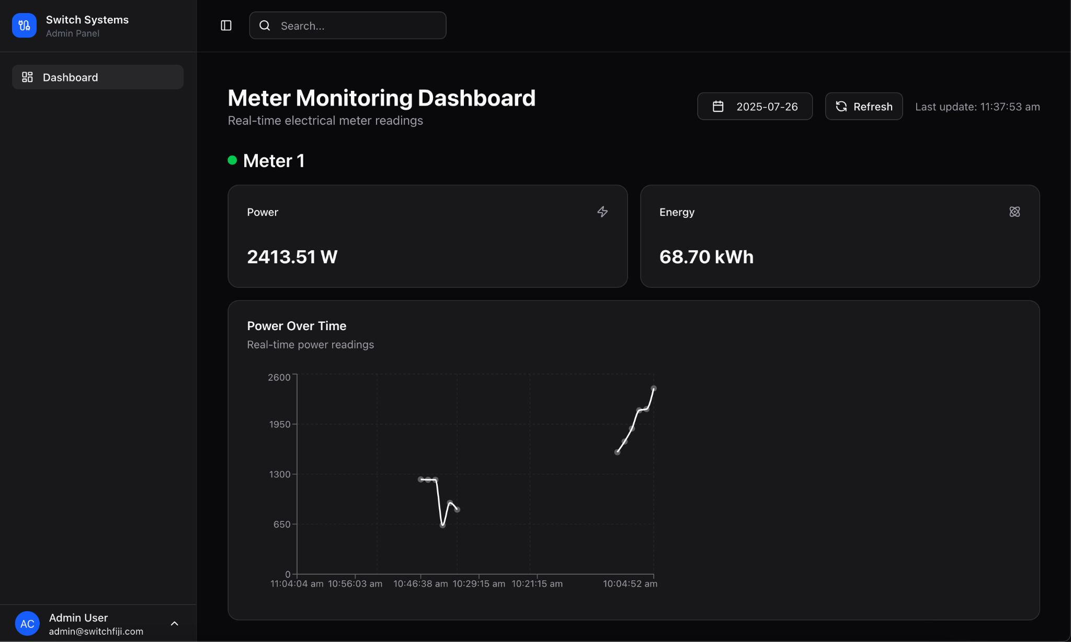
Demo

Slide 11

Any Questions?

